Slide 1
CS61C: Great Ideas in Computer Architecture (aka Machine Structures)
Lectures 12+13: RISC-V Instruction Formats
Instructors: Lisa Yan, Justin Yokota
To jump to the start of Lecture 13, click here (slide ~29)

Slide 2
Agenda
Lecture 12
Intro
R-types
I-types
S-types
Lecture 13
U-types
B-types
J-types
Concluding Notes
(Putting these two lectures together so it's easier to reference later)

Slide 3
Agenda
Intro
R-types
I-types
S-types
U-types
B-types
J-types
Concluding Notes

Slide 4
Agenda
Intro
R-types
I-types
S-types
U-types
B-types
J-types
Concluding Notes

Slide 5
Overview
Assembly languages are primarily useful because they can be directly translated into binary code that can be run by a CPU.
RISC-V has a particularly simple structure: Each instruction is translated into instructions of the same length; for RV32 (the version we learn in this class), each instruction is 32 bits (4 bytes) long.
Different instructions require different values
"add" specifies 3 register inputs
"addi" specifies 2 registers and 1 immediate
As such, we define multiple formats, with each instruction getting encoded in its format.
Overall design philosophy: Split the 32 bits into "chunks" for each component of an instruction, and try to overlap these chunks as much as possible to simplify the underlying circuit.
Most of this information is presented in compressed form on our reference card, so there's no need to memorize the exact numbers associated with each instruction

Slide 6
Agenda
Intro
R-types
I-types
S-types
U-types
B-types
J-types
Concluding Notes

Slide 7
R-Type
Start/End bit indexes of field
31
25
24
20
19
15
14
12
11
7
6
0
funct7
rs2
rs1
funct3
rd
opcode
7
5
5
3
5
7
Name of field
Number of bits in field

Slide 8
R-Type
Start/End bit indexes of field
31
25
24
20
19
15
14
12
11
7
6
0
funct7
rs2
rs1
funct3
rd
opcode
7
5
5
3
5
7
Name of field
Number of bits in field
Designed for instructions with 3 registers and no immediate
Arithmetic operators like add or sub
Each register is identified by its number. 32 registers → 5 bits to identify one register uniquely
x0 → 0b00000
a0 → x10 → 0b01010
rd: Destination register
rs1: 1st source register
rs2: 2nd source register

Slide 9
R-Type
Start/End bit indexes of field
31
25
24
20
19
15
14
12
11
7
6
0
funct7
rs2
rs1
funct3
rd
opcode
7
5
5
3
5
7
Name of field
Number of bits in field
opcode: Instruction identifier: Always the last 7 bits of the instruction over all instruction formats
Can therefore be used to determine which instruction format is currently in use.
Some sets of similar instructions get assigned the same opcode
Ex. All arithmetic R-type instructions have the opcode 0x33
funct3: 3-bit identifier to differentiate instructions with the same opcode
funct7: Extra 7-bit identifier for extremely similar instructions with the same opcode and funct3 (such as sra and srl)

Slide 10
R-Type: Example Translation
Start/End bit indexes of field
31
25
24
20
19
15
14
12
11
7
6
0
funct7
rs2
rs1
funct3
rd
opcode
7
5
5
3
5
7
Name of field
Number of bits in field
Translate "add s2 s3 s4" to hex
Step 1: Determine opcode and instruction type from reference card
Type: R
Opcode: 0b011 0011
funct3: 0b000
funct7: 0b000 0000
Step 2: Write out format
0b ??????? ????? ????? ??? ????? ???????

Slide 11
R-Type: Example Translation
Start/End bit indexes of field
31
25
24
20
19
15
14
12
11
7
6
0
funct7
rs2
rs1
funct3
rd
opcode
7
5
5
3
5
7
Name of field
Number of bits in field
Translate "add s2 s3 s4" to hex
Step 3: Registers
s2 -> x18 ->0b10010 (rd)
s3 -> x19 ->0b10011 (rs1)
s4 -> x20 ->0b10100 (rs2)
0b 0000000 10100 10011 000 10010 0110011

Slide 12
R-Type: Example Translation
Start/End bit indexes of field
31
25
24
20
19
15
14
12
11
7
6
0
funct7
rs2
rs1
funct3
rd
opcode
7
5
5
3
5
7
Name of field
Number of bits in field
Translate "add s2 s3 s4" to hex
Step 1: Determine opcode and instruction type from reference card
Type: R
Opcode: 0b011 0011
funct3: 0b000
funct7: 0b000 0000
Step 2: Write out format
0b 0000000 ????? ????? 000 ????? 0110011

Slide 13
R-Type: Example Translation
Start/End bit indexes of field
31
25
24
20
19
15
14
12
11
7
6
0
funct7
rs2
rs1
funct3
rd
opcode
7
5
5
3
5
7
Name of field
Number of bits in field
Translate "add s2 s3 s4" to hex
Step 4: Convert to hex
0b 0000000 10100 10011 000 10010 0110011
0b 0000 0001 0100 1001 1000 1001 0011 0011
0x01498933

Slide 14
R-Type: Example Translation
Start/End bit indexes of field
31
25
24
20
19
15
14
12
11
7
6
0
funct7
rs2
rs1
funct3
rd
opcode
7
5
5
3
5
7
Name of field
Number of bits in field
Translate "0x01B3 42B3" to RV32 instruction
Step 1: Convert to binary and determine opcode and instruction type from reference card
Binary: 0b0000 0001 1011 0011 0100 0010 1011 0011
Opcode: last 7 bits = 0b011 0011
Conclusion: R-type instruction
Updated in class from “Translate … to hex”

Slide 15
R-Type: Example Translation
Start/End bit indexes of field
31
25
24
20
19
15
14
12
11
7
6
0
funct7
rs2
rs1
funct3
rd
opcode
7
5
5
3
5
7
Name of field
Number of bits in field
Translate "0x01B3 42B3" to RV32 instruction
Step 2: Split according to R-type format
Binary: 0b0000000 11011 00110 100 00101 0110011
Step 3: Determine funct3/funct7 for instruction
funct3: 0b100
funct7: 0b000 0000
Conclusion: xor operation

Slide 16
R-Type: Example Translation
Start/End bit indexes of field
31
25
24
20
19
15
14
12
11
7
6
0
funct7
rs2
rs1
funct3
rd
opcode
7
5
5
3
5
7
Name of field
Number of bits in field
Translate "0x01B3 42B3" to RV32 instruction
Step 2: Split according to R-type format
Binary: 0b0000000 11011 00110 100 00101 0110011
Step 4: Determine registers
rd: 0b00101 -> x5 -> t0
rs1: 0b00110 -> x6 -> t1
rs2: 0b11011 -> x27-> s11
Conclusion: xor t0 t1 s11

Slide 17
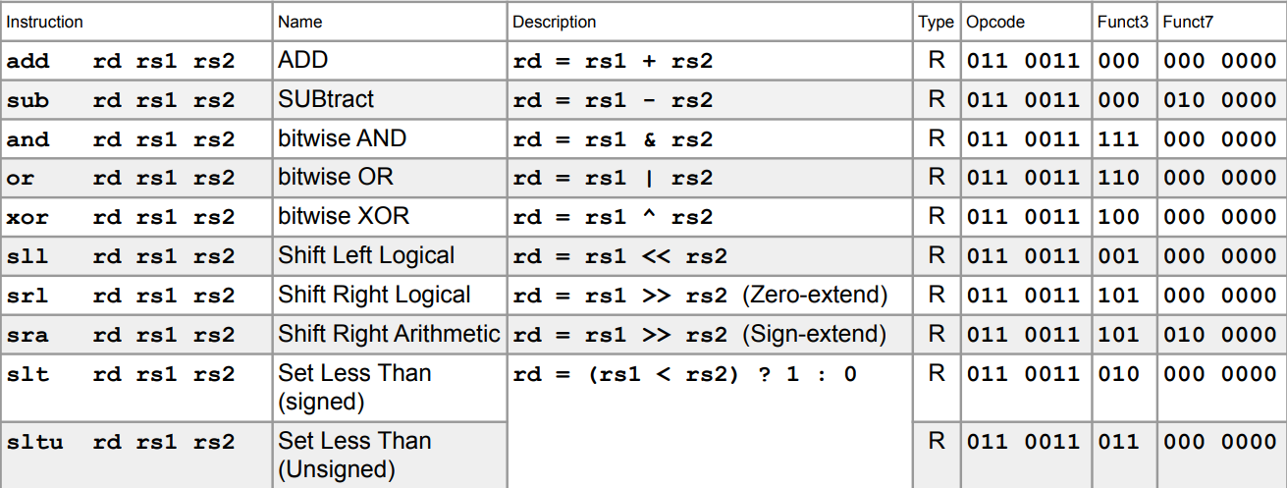
R-Type: All Instructions

Slide 18
Agenda
Intro
R-types
I-types
S-types
U-types
B-types
J-types
Concluding Notes

Slide 19
I-Type
31
20
19
15
14
12
11
7
6
0
imm[11:0]
rs1
funct3
rd
opcode
12
5
3
5
7

Slide 20
I-Type
31
20
19
15
14
12
11
7
6
0
imm[11:0]
rs1
funct3
rd
opcode
12
5
3
5
7
Designed for instructions with 2 registers (rs1 and rd) and 1 immediate
Arithmetic operations with immediates
Loads
jalr
ecall and ebreak are also technically I-types, but they ignore the rd, rs1, and immediate, and their value isn't really in scope.
Stores use rs1 and rs2, so we have a separate instruction format for them.
Most components are stored the same way as before, with the addition of the imm component

Slide 21
I-Type
31
20
19
15
14
12
11
7
6
0
imm[11:0]
rs1
funct3
rd
opcode
12
5
3
5
7
Immediate is stored in the component imm
Note the [11:0], which indicates that we store the 11th bit of the immediate at position 31, the 10th bit of the immediate at position 30, …, the 0th bit of the immediate at position 20
I-type immediates are 12 bits
Therefore, we can only store a 12-bit integer as an immediate
Most instructions use signed immediates, so our range for I-type immediates is [-2048,2047].
Ex. "addi sp sp -2048" is valid, but "addi sp sp -2052" is NOT valid RISC-V code

Slide 22
I*-Type
31
25
24
20
19
15
14
12
11
7
6
0
funct7
imm[4:0]
rs1
funct3
rd
opcode
7
5
5
3
5
7
Special note: For shift instructions (slli, srli, srai), we only have a max shift of 31
Any larger shift will shift all our data off the number
As such, these instructions use a modified I-type that specifies a funct7

Slide 23
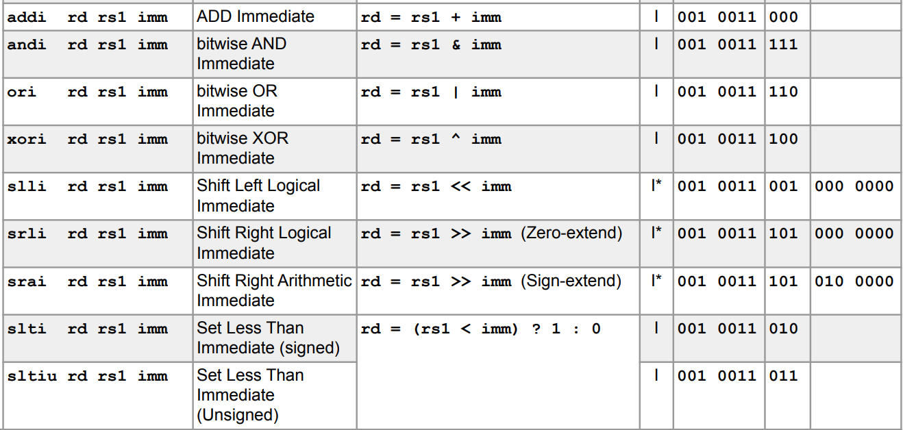
I-Type: Arithmetic Instructions

Slide 24
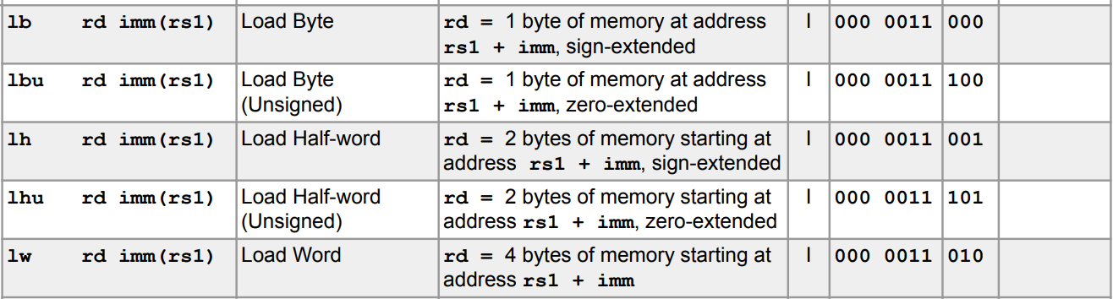
I-Type: Load and Jump Instructions

Slide 25
Agenda
Intro
R-types
I-types
S-types
U-types
B-types
J-types
Concluding Notes

Slide 26
S-Type
31
25
24
20
19
15
14
12
11
7
6
0
imm[11:5]
rs2
rs1
funct3
imm[4:0]
opcode
7
5
5
3
5
7
Designed for instructions with 2 source registers and an immediate
Store instructions
Note that we put rs1 and rs2 in the same spots as in R-type instructions, so we need to split the immediate bits to "fill in" the remaining gaps.
Immediate is similar, but now we need to "piece together the immediate"
Ex. If we had immediate 0b1101 0101 0001, then we would put 0b110 1010 in the first immediate box, and 0b10001 in the second immediate box.

Slide 27
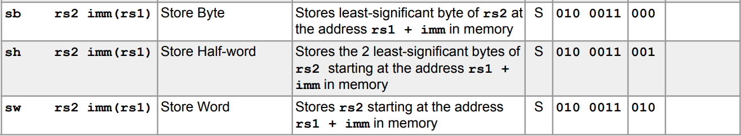
S-Type: All Instructions
Warning: rs2 comes before rs1 in store instructions!
This is because we want rs1 to always be the register that gets added to immediates, to simplify our circuitry

Slide 28
Practice: Translate an instruction!
The code for this is embedded in HW, so it will not be made public.

Slide 29
CS61C: Great Ideas in Computer Architecture (aka Machine Structures)
Lectures 12+13: RISC-V Instruction Formats
Instructors: Lisa Yan, Justin Yokota

Slide 30
Extenuating Circumstances Extension Philosophy
One of the learning goals is early communication and time management
This includes being able to own up to your responsibilities when you cannot make this deadline
The deadline that we consider is the on-time submission deadline. You are expected to be trying to make this on-time deadline.
Labs/Projects: Tuesday
Homeworks: Thursday
Philosophy: The guaranteed extension (1 day for labs/hw, 2 days for proj):
is supposed to be a safety net for unanticipated issues that come up that directly impact your ability to complete the assignment by the original deadline
is not intended to be used as an adjusted deadline so you can focus on other work instead

Slide 31
Extenuating Circumstances Extensions PSA
What we’re noticing:
Lots of people are using the guaranteed extension policy and extenuating circumstances form as intended. ✅
⚠️ However, there is a subset of students that are misusing the policy, massively increasing staff overhead and reducing staff capacity to support concurrent assignments.
What we look for when you submit to the extenuating circumstances form:
Did you reach out before the original deadline?
If not, when did you start the assignment? Was it before the original deadline?
PrairieLearn has detailed logs; please commit often for labs and projects
Is this recurring? Have you submitted to the form before?
Mostly used to determine if a face-to-face meeting is necessary
Now that we’ve settled into the semester, we will be enforcing this policy.
More details to be released in next week’s announcements.

Slide 32
Agenda
Intro
R-types
I-types
S-types
U-types
B-types
J-types
Concluding Notes

Slide 33
U-type instructions: lui and auipc
Up until now, we haven't talked about what these two instructions actually do
Load Upper Immediate: lui rd imm
Sets rd to imm << 12
Add Upper Immediate to Program Counter: auipc rd imm
Sets rd to (imm << 12) + PC
Primarily used in two pseudoinstructions:
li rd imm: Set rd to imm
la rd Label: Set rd to the address of Label

Slide 34
LUI
Consider li:
How would you translate "li t0 0x12345678" to instructions?
Can't just do "addi t0 x0 0x12345678" because that's way too big
Multiple addis or addis with sllis would work, but require many instructions for some numbers.
Ideally, we want to be able to do this in exactly 2 instructions
1 instruction is impossible since no 32-bit object can encode all 2³² possible immediates AND all 32 possible destination registers
Solution: lui instruction
In the above example, we can do:
lui t0 0x12345 addi t0 t0 0x678
This works, as long as we give U-type instructions 20 bits of immediate

Slide 35
LUI: Corner case
How would you translate "li t0 0xABCDEFFF" to instructions?
Initial idea:
lui t0 0xABCDE addi t0 t0 0xFFF
Problem: 0xFFF isn't 4095; it's -1
After the first line, we get t0 = 0xABCDE000
After the second line, we get t0 = 0xABCDDFFF instead!
As such, we need to be careful in this case and do lui t0 0xABCDF instead
lui t0 0xABCDF #t0 stores 0xABCDF000 addi t0 t0 0xFFF #t0 stores 0xABCDEFFF
This ends up affecting li instructions only when the offset has its 11th bit set to 1, so it's an easy case to forget about.

Slide 36
AUIPC and Relative Addressing
auipc similarly gets used primarily as a way to save an arbitrary value when used with an addi
The main difference is that it adds its result to PC
Often when writing code, we want to allow multiple programs to be combined (like with libraries), but that would change the addresses of all the labels in our code
To avoid this issue, many instructions involving labels use relative addressing instead of absolute addressing.
Absolute address: "This label is at location 0x000000FC". This fails if we move our code to a different place in memory
Relative address: "This label is 48 bytes after the current line of code". This still works if we move both the line of code and the label the same distance.
As such, auipc often gets used with la instructions.

Slide 37
U-Type
31
12
11
7
6
0
imm[32:12]
rd
opcode
20
5
7
Designed for instructions which need 20 immediate bits
lui and auipc
Note that there's a slight inconsistency between how the immediate is treated in the instruction format compared to the instruction itself
Note that the instruction format listed here doesn't store the bottom 12 bits of the value imm
If we write "lui t0 0x12345", we should treat imm as 0x12345000, and thus store 0x12345 in those 20 bits, instead of 0x00123.
This is due to RISC-V not actually having a formal syntax (RISC-V only specifies the binary encoding), so the syntax that got adopted was a variation of x86 syntax

Slide 38
U-Type: All Instructions

Slide 39
Agenda
Intro
R-types
I-types
S-types
U-types
B-types
J-types
Concluding Notes

Slide 40
Labels
Recall: Labels don't actually exist. When translating RISC-V to binary, we need to convert all labels into explicit references to a particular line of code
Recall: Since we want to be able to move around code blocks in memory, we prefer to use relative addressing instead of absolute addresses.
Solution: When writing code using labels, first convert the label into an offset, which specifies how many bytes off we would need to jump to get to that label.

Slide 41
Example: Converting Labels into offsets
Translate the labels in the following code into their corresponding offsets:
beq x0 x0 target addi x0 x0 100 target: addi x0 x0 100 j target li t0 0x5F3759DF beq t0 t0 target

Slide 42
Example: Converting Labels into offsets
Translate the labels in the following code into their corresponding offsets:
beq x0 x0 target #+2 instructions = 8 bytes, so offset=8 addi x0 x0 100 target: addi x0 x0 100 j target li t0 0x5F3759DF beq t0 t0 target

Slide 43
Example: Converting Labels into offsets
Translate the labels in the following code into their corresponding offsets:
beq x0 x0 target #+2 instructions = 8 bytes, so offset=8 addi x0 x0 100 target: addi x0 x0 100 j target # -1 instruction = -4 bytes, so offset=-4 li t0 0x5F3759DF beq t0 t0 target

Slide 44
Example: Converting Labels into offsets
Translate the labels in the following code into their corresponding offsets:
beq x0 x0 target #+2 instructions = 8 bytes, so offset=8 addi x0 x0 100 target: addi x0 x0 100 j target # -1 instruction = -4 bytes, so offset=-4 li t0 0x5F3759DF #The li here is actually 2 instructions beq t0 t0 target #-4 instructions, so offset=-16

Slide 45
Storing offsets
Note that all the previous offsets were multiples of 4
Each instruction is always going to take 4 bytes of memory, so all offsets should be multiples of 4
If we stored the immediate directly as a signed number, we'd always have the last two bits 0s.
At the same time, we have only a limited number of bits to store an immediate, which limits the total distance we can jump
If we can decide not to store those 0 bits, we can extend our immediate and allow for longer jumps
Therefore, we don't store the lowest bit of an offset immediate
Some RISC-V extensions use 16-bit instructions, so we can't choose not to store the bottom two bits

Slide 46
B-Type
31
25
24
20
19
15
14
12
11
7
6
0
imm[12|10:5]
rs2
rs1
funct3
imm[4:1|11]
opcode
7
5
5
3
5
7
Branch instructions also use 2 source registers and an immediate, so the format is similar to S-Type
This format is sometimes referred to as SB-type for that reason
Note that the immediate is stored in a strange pattern
If we had the binary 0bA BCDE FGHI JKLM (where each letter was a bit), the first box would store 0bACD EFGH and the second box would store 0bI JKLB. Bit M isn't stored.
This is also to simplify the underlying circuit; note that we put the MSB of our immediate in the MSB of our instruction (to simplify sign-extension), and other than that put 10 of the remaining 11 bits in the same position as S-type instructions
Branch instructions have 13-bit immediates = [-4096, 4094] range, which is up to 2¹⁰ instructions up/down.

Slide 47
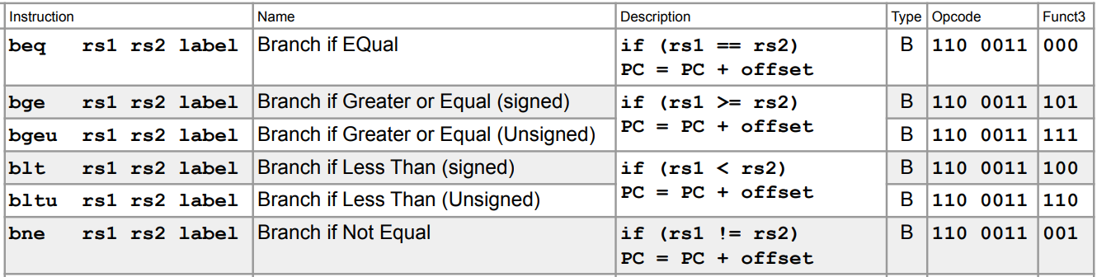
B-Type: All Instructions

Slide 48
Agenda
Intro
R-types
I-types
S-types
U-types
B-types
J-types
Concluding Notes

Slide 49
J-Type
31
12
11
7
6
0
imm[20|10:1|11|19:12]
rd
opcode
20
5
7
Jal instructions use only 1 destination and an immediate, so we can use the U-type format for extra immediate bits
This format is sometimes referred to as UJ-type for that reason
Note that the immediate is stored in an even stranger pattern
If we had the binary 0bA BCDE FGHI JKLM NOPQ RSTU (where each letter was a bit), the data would be stored as 0b AKLM NOPQ RSTJ BCDE FGHI. As before, the last bit isn't stored
Note that we put the MSB of our immediate in the MSB of our instruction, bits 19-12 in the same spot as U-types, and bits 10-1 in the same spot as I-types.
Jumps have 21-bit immediates, so up to 2¹⁸ instructions up/down

Slide 50
J-Type: All Instructions

Slide 51
Agenda
Intro
R-types
I-types
S-types
U-types
B-types
J-types
Concluding Notes

Slide 52
How to handle immediates larger than you can store
R-type and U-type instructions
Unneeded, since they either don't have immediates or have very specific use cases that never need to exceed the given immediate length
I-type and S-type instructions
For arithmetic instructions, it's generally possible to store the immediate in a temporary first
Ex. if we want to do "xori t0 t1 0xDEADBEEF", we can do: li t2 0xDEADBEEF xor t0 t1 t2
For loads and stores, we can add the offset first, then do a 0-offset load (as with variable offset loads)
Adjusted xor t0 t1 0xDEADBEEF to xori in lecture

Slide 53
How to handle immediates larger than you can store
B-type and J-type instructions
If a branch is:
Within 1024 instructions?
Branch normally (ex. beq t0 t1 Label)
Greater than 1024 instructions?
Invert the branch condition, and do a j instruction instead: bne t0 t1 Next j Label Next:
If a jump is:
Within 2¹⁸ instructions?
Jump normally (ex. j Label)
Greater than 2¹⁸ instructions?
Do an auipc, then use jalr's immediate to offset the rest: auipc t0 0x12345 jalr ra t0 0x678

Slide 54
Summary
Information on instruction formats and specific opcode/funct values are provided on the reference card here: https://cs61c.org/sp24/pdfs/resources/reference-card.pdf

